Slide 1
The Maze using Breadth-First Traversal
Kaustuv Giri

Slide 2
Table of Content
Abstract
Introduction
Design
Implementation
Test
Conclusion
References

Slide 3
Abstract
Objective: Efficiently traverse mazes using the BFS algorithm.
Method: Implement a concise and elegant BFS solution for maze navigation.
Scope: Explore diverse maze configurations and assess BFS performance.
Achievements: Successfully traverse mazes with rigorous testing.
Results: Showcase BFS efficiency and reliability in complex mazes.
Conclusions: Provide insightful findings and future recommendations.

Slide 4
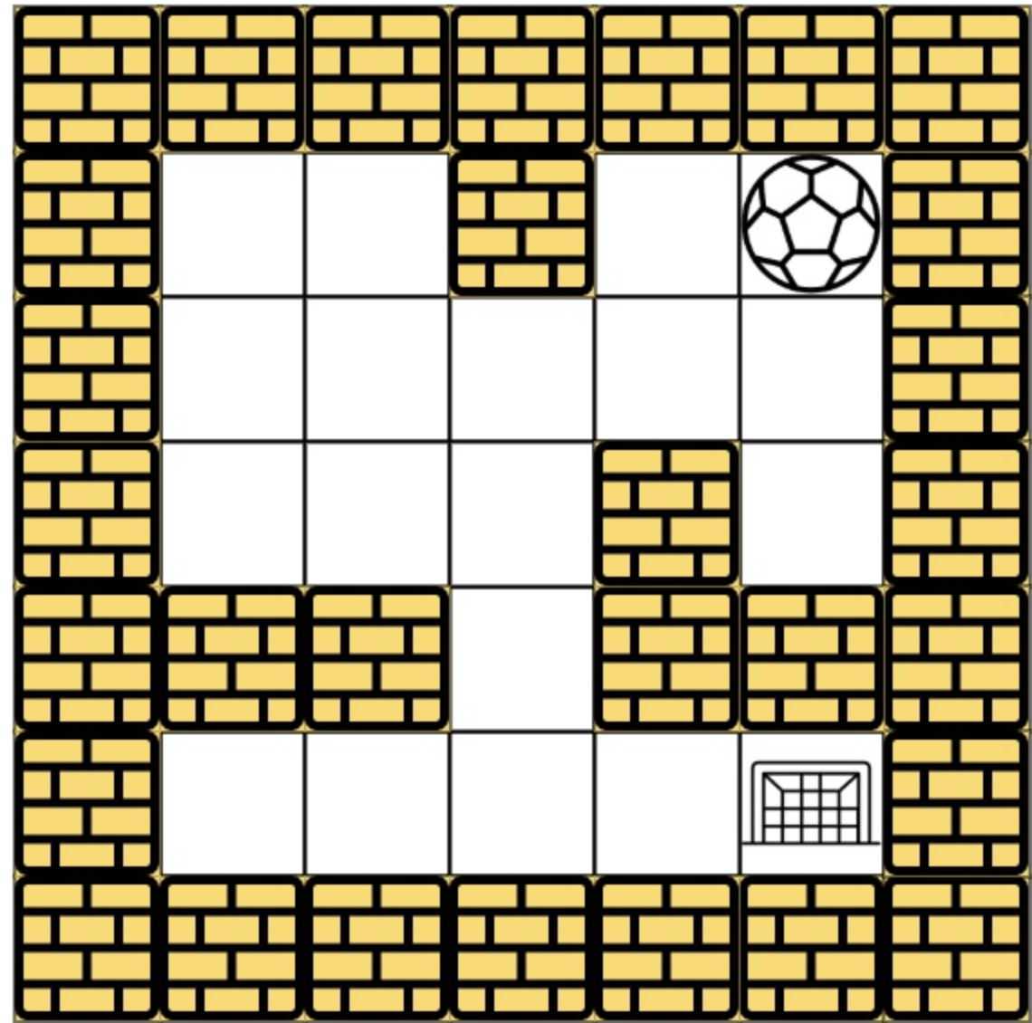
Introduction
Project Objective: Traverse from starting point to finishing line inside a maze.
Approach: Utilize Depth-First Search (BFS) algorithm for efficient maze traversal.
Concise Implementation : Accomplish the maze-solving goal with an elegantly concise implementation, highlighting the power of BFS.

Slide 5
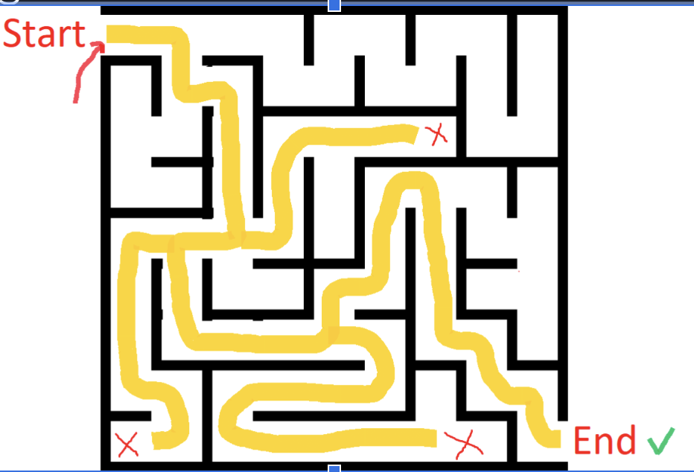
Design
Can BFS successfully traverse through a maze?
BFS is a powerful method for maze traversal.
It explores cells layer by layer, expanding in all directions from the starting point.
The algorithm ensures the shortest path is found first.
Visited cells are marked to avoid revisiting, making it efficient.
BFS is highly effective for finding paths in complex mazes.

Slide 6
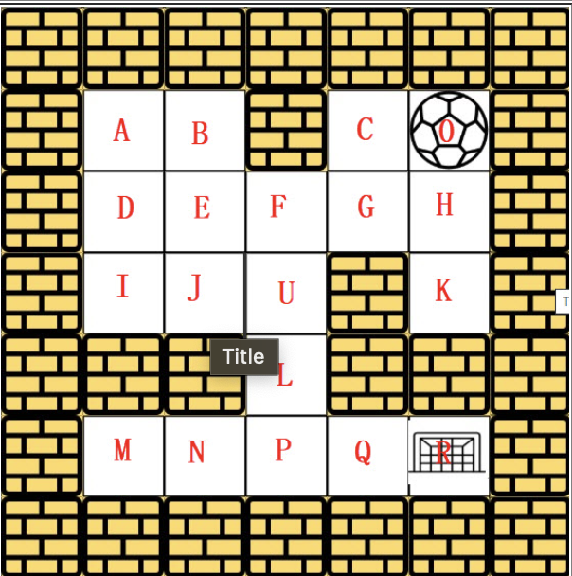
Design
Treat the maze as a 2D grid, where each cell is considered a vertex for exploration.
The walls of each cell are obstacles and are not explicitly represented as edges in BFS.
Use a queue to manage the coordinates of cells for exploration.
Start from the initial position (start) and enqueue it.
While the queue is not empty, dequeue the front cell and explore its adjacent open spaces (up, down, left, right) for further exploration. Mark each explored cell as visited to avoid re-exploration.
Continue this process until the destination cell is found or all possible paths are explored.

Slide 7
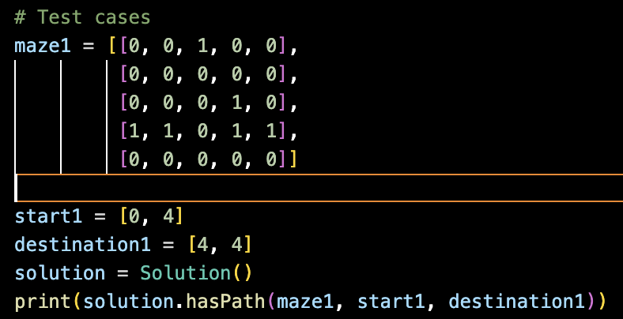
Implementation
Represent the cells as 2D matrix
Input the starting and the ending position

Slide 8
Implementation in summary
The class Solution contains methods to traverse the maze and check if there exists a path from the starting point to the destination.
The BFS approach is used to explore potential paths in the maze by exploring all directions from the current position layer by layer.
A queue is utilized to keep track of cells to explore. We start with the starting position in the queue and add adjacent cells to the queue while exploring each layer.
A visited set is used to keep track of explored cells during maze traversal.
We initialize the visited set as an empty set before starting the BFS traversal.
The coordinates of each explored cell (start) are added to the visited set to avoid revisiting.

Slide 9
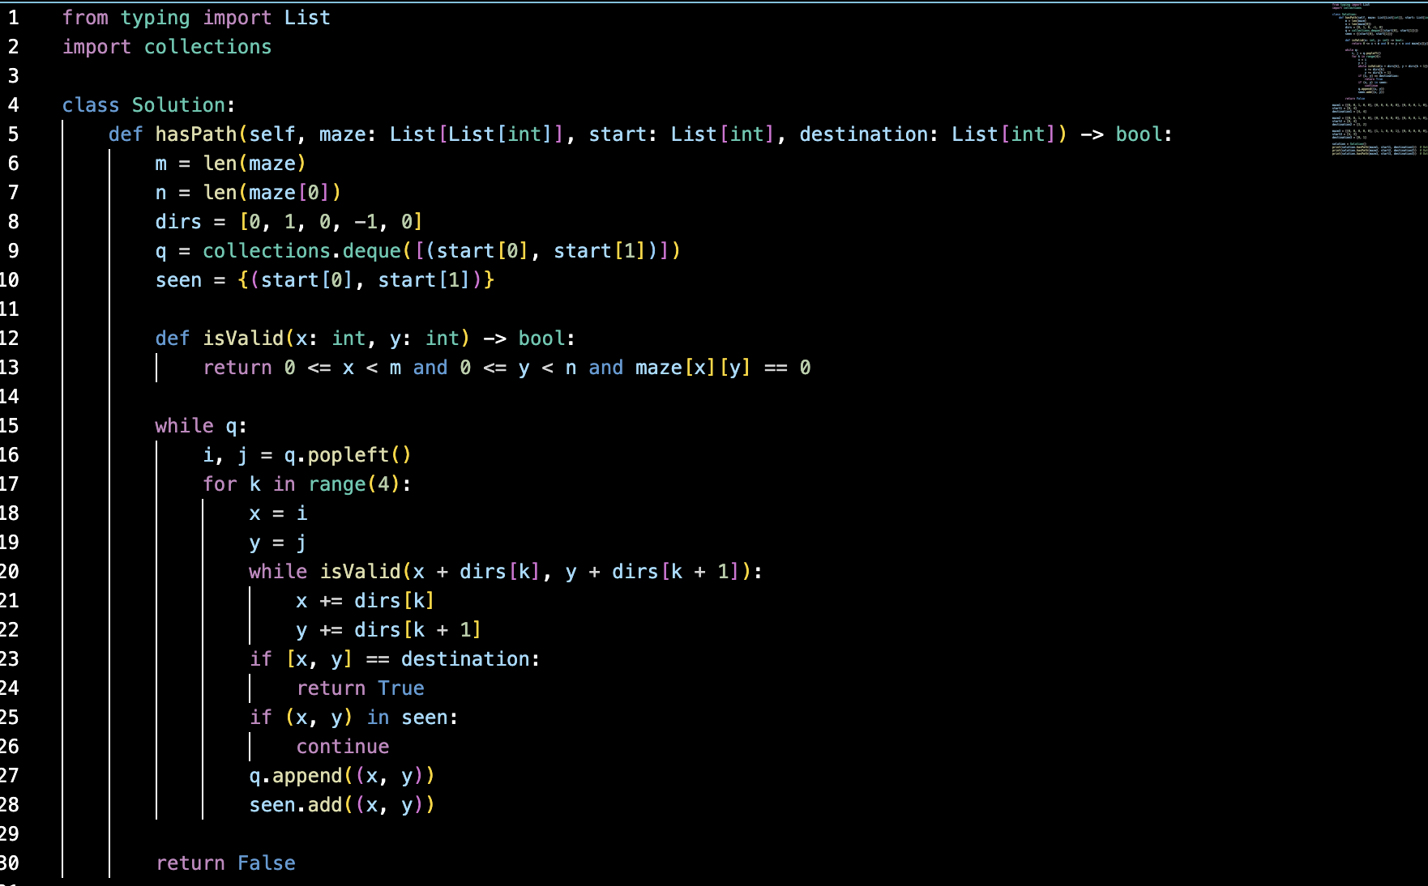
Algorithm

Slide 10
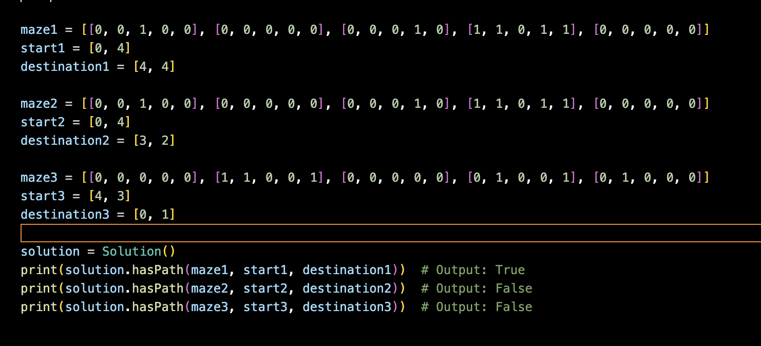
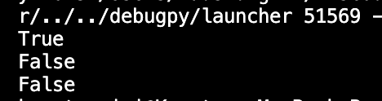
Test Cases

Slide 11
Conclusion
BFS effectively navigates mazes from the start to destination.
Utilizing a visited set optimizes exploration and prevents revisiting cells.
The concise implementation of BFS makes it a versatile and reliable maze-solving technique.

Slide 12
References
Leetcode
Prof Henry Chang website
ChatGpt How to solve BFSmaze using python

